Slide 1
PCB DESIGN

Slide 2
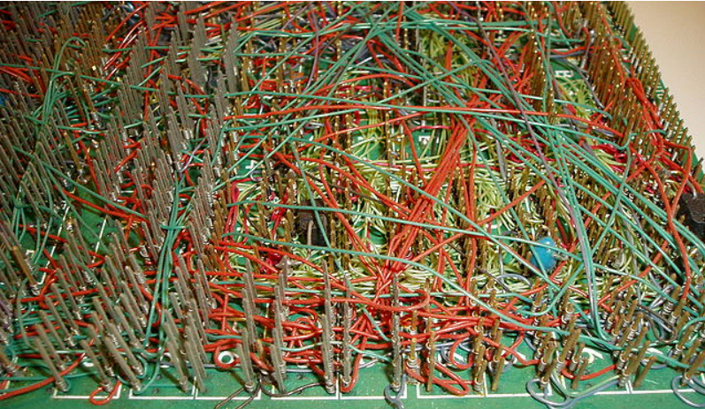
PCB
Printed circuit board is the most common name but may also be called "printed wiring boards" or "printed wiring cards".
Before the advent of the PCB circuits were constructed through a laborious process of point-to-point wiring.
This led to frequent failures at wire junctions and short circuits when wire insulation began to age and crack.

Slide 3
PCB
Also called printed circuit board
It is a board that has lines and pads that connect various points together.
there are traces that electrically connect the various connectors and components to each other.
A PCB allows signals and power to be routed between physical devices.

Slide 4
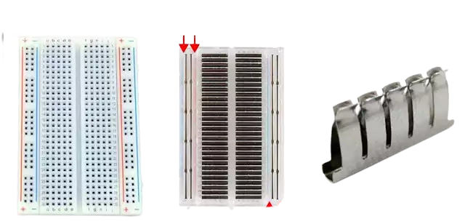
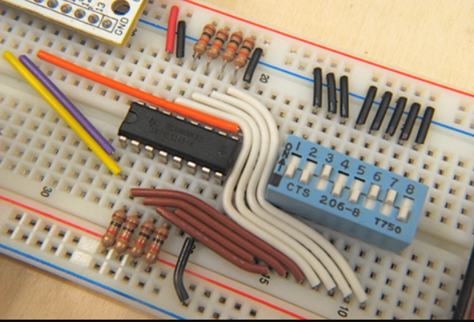
Bread Board

Slide 5
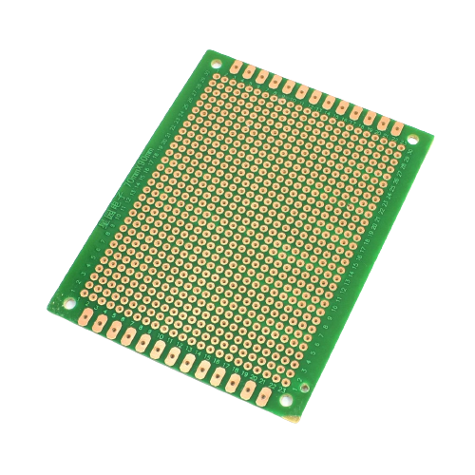
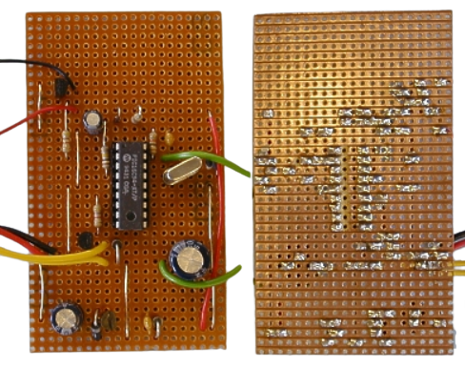
Matrix Board

Slide 6
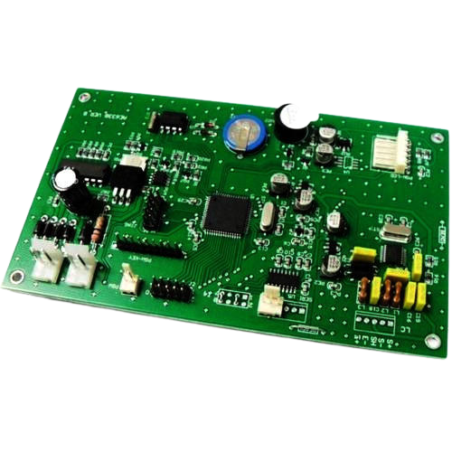
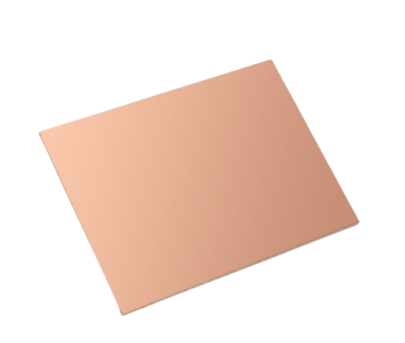
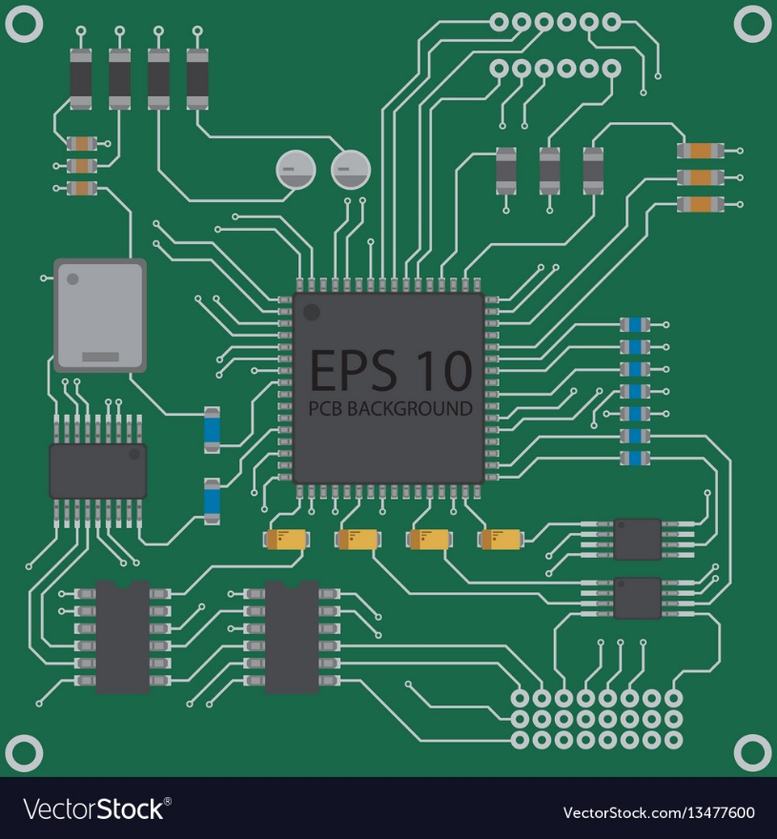
PCB

Slide 7
Things To Remember While Designing PCB
Sizing Traces:
As we know, copper traces have resistance. Which means that it has a voltage drop, power dissipation, and a temperature rise when current flows through it
Resistance (R) = (Resistivity × Length)/(Thickness × Width)
Resistance is actually a physical property of the metal that is used to make the trace.

Slide 8
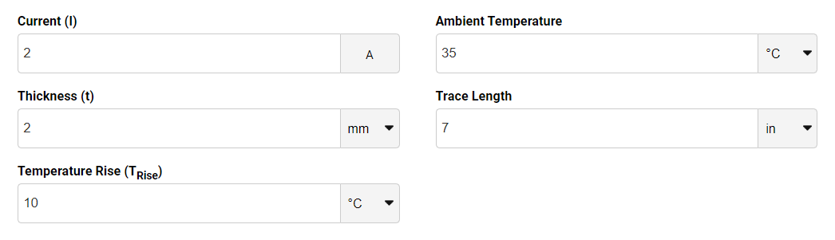
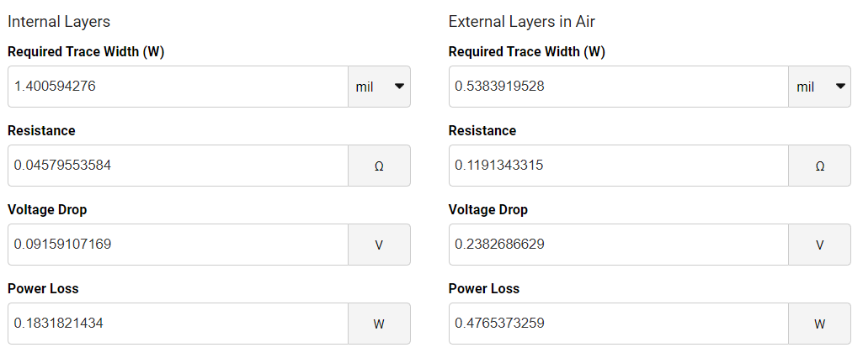
Things To Remember While Designing PCB
Sizing Traces:

Slide 9
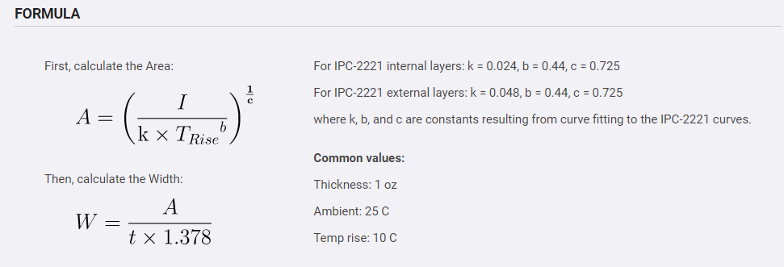
Things To Remember While Designing PCB
Sizing Traces:

Slide 10
Things To Remember While Designing PCB
Make Loops Small
Small loops have lower inductance and resistance, loops, especially the high frequency loops, should be made as small as possible.
Having small loops reduces high frequency voltage spikes that are caused by
V =L (di/dt)
It also help in reducing noise

Slide 11
Things To Remember While Designing PCB
Decoupling Capacitor Placement
The decoupling capacitors should be placed as near as possible to the power and ground pins of integrated circuits to maximize decoupling efficiency.
Placing capacitors farther away introduces stray inductance.
If frequency of noise is less than 50mhz then Ceramic Capacitor can be used (10nF or 0.1uF) and for noise greater than 50Mhz multiple capacitor must be used
Low frequency noise electrolytic capacitor is used and if high frequency noise is there ceramic capacitor is used.

Slide 12
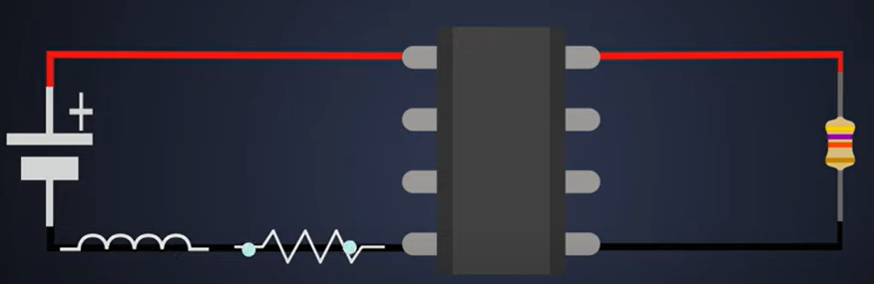
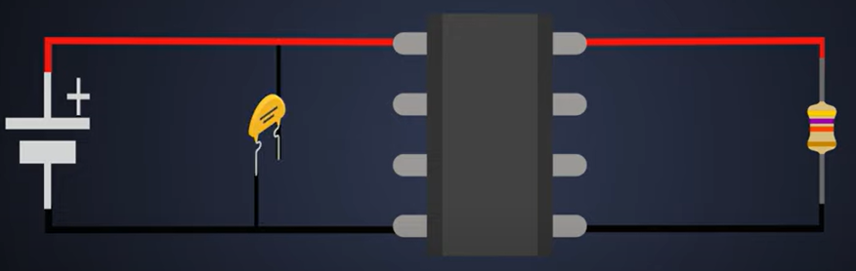
Things To Remember While Designing PCB
Decoupling Capacitor Placement

Slide 13
Things To Remember While Designing PCB
Decoupling Capacitor Placement
Mainly ceramic Capacitors are used for decoupling because of
Wide Temperature
Wide voltage
Low ESR(equivalent series resistance)
Stability and Reliability

Slide 14
Things To Remember While Designing PCB
Ground
Hence, you should take care to route noisy grounds away from signals that need to be quiet.
You can make ground traces large enough to carry the currents that will flow. It’s ideal to place a ground plane directly under signal traces lowers the impedance of the traces.

Slide 15
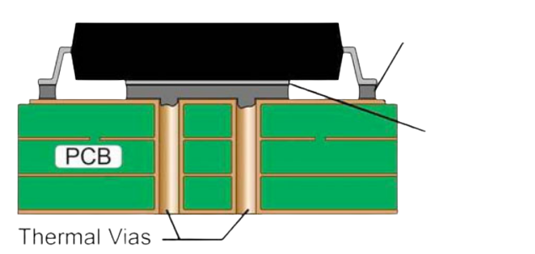
Things To Remember While Designing PCB
Via
It is especially used to shorten the length of the track
Types
Thermal Via
Via can be used to transfer heat from one side of a PCB to the other.
This is especially useful in case where a PCB is mounted on a heatsink on a chassis which further dissipate heat.

Slide 16
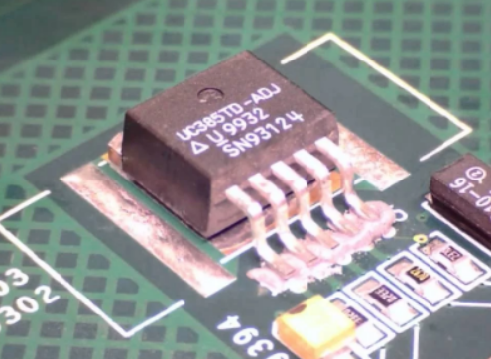
Things To Remember While Designing PCB
Using PCB as Heatsink
Placing extra copper around surface mount component can provide extra surface area to dissipate heat more efficiently.

Slide 17
Things To Remember While Designing PCB
Distance between Traces and Mounting Holes
Leaving space between copper traces or fills and mounting holes helps in preventing shock hazards.
Since, solder mask is not a reliable insulator, you should always take care that there is distance between copper and any mounting hardware.

Slide 18
Things To Remember While Designing PCB
Heat Sensitive Components
In a PCB. components that are sensitive to heat must be kept away from the other components that generate heat.
Example of components that generate heat are bridge rectifiers, diodes, MOSFETs, inductors, and resistors.
The heat generated by these components depends on the current flowing through them.

Slide 19
PCB Design Software Tools
PCB Artist
SOLIDWORKS PCB
PCB WEB
KiCad EDA
EasyEDA

Slide 20
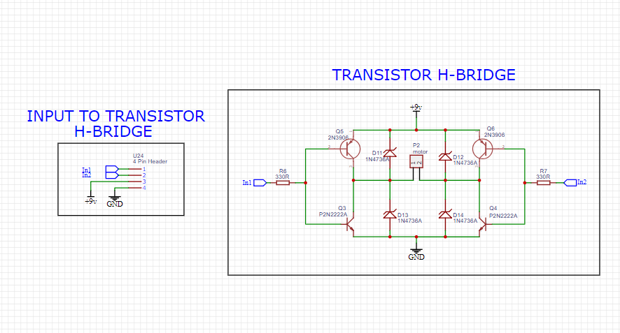
How To Make Schematic

Slide 21
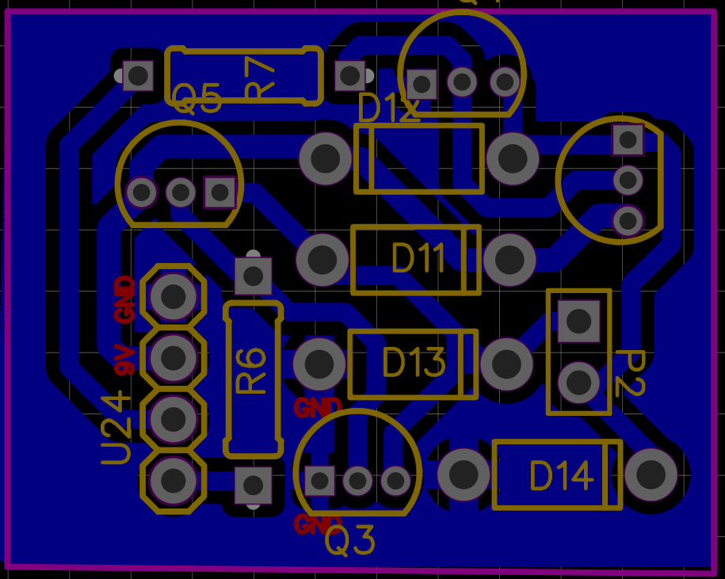
Final PCB

Slide 22
PCB Fabrication Process
Clean PCB
Make PCB dry
Print Designed Circuit to the PCB Board
Iron it
Do Etching
Ferric Chloride(1:1 with Water)
Hydrogen Chloride and Hydrogen Peroxide
Clean PCB With water to remove Ferric Chloride
Remove Printed Color form PCB With Acetone

Slide 23
PCB Fabrication Process
Green Masking:
Solder Resister Greening and catalyst (2:1) and dilute it
Drill The PCB
Place Component and Solder It

Slide 24
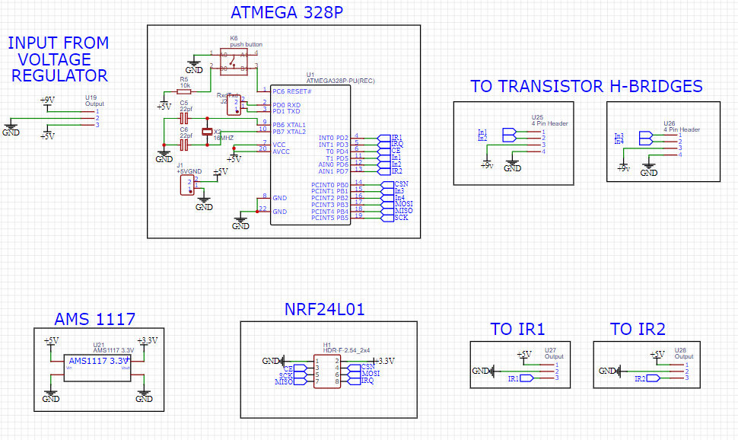
How To Make Schematic

Slide 25
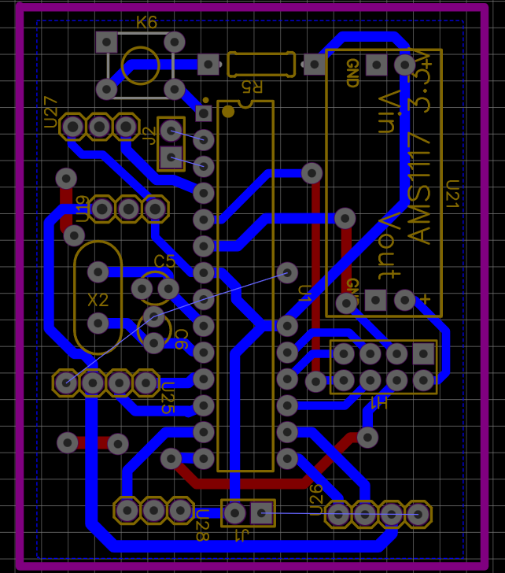
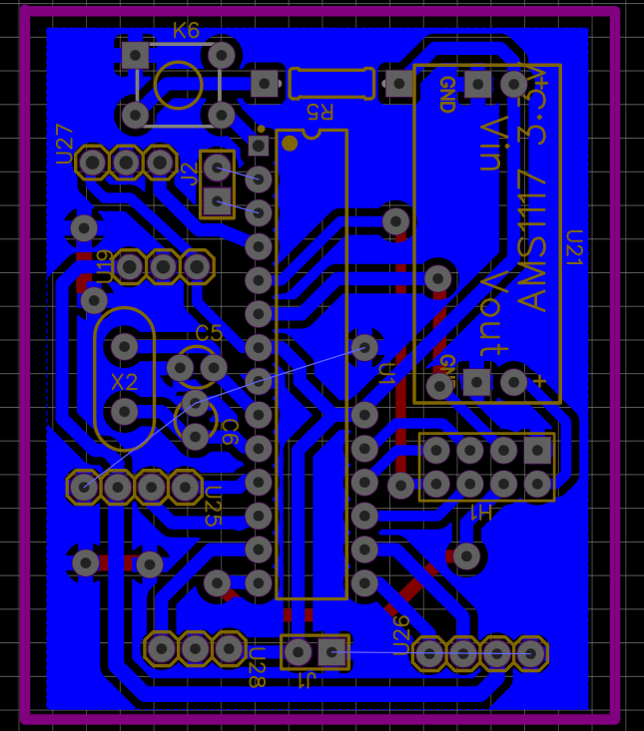
Final PCB

